Slide 1
Audiophobia Uva 10048
Time: 3 seconds

Slide 2
Problem Description(1/3)
Consider yourself lucky! Consider yourself lucky to be still breathing and having fun participating in this contest. But we apprehend that many of your descendants may not have this luxury. For, as you know, we are the dwellers of one of the most polluted cities on earth. Pollution is everywhere, both in the environment and in society and our lack of consciousness is simply aggravating the situation.
However, for the time being, we will consider only one type of pollution - the sound pollution. The loudness or intensity level of sound is usually measured in decibels and sound having intensity level 130 decibels or higher is considered painful.

Slide 3
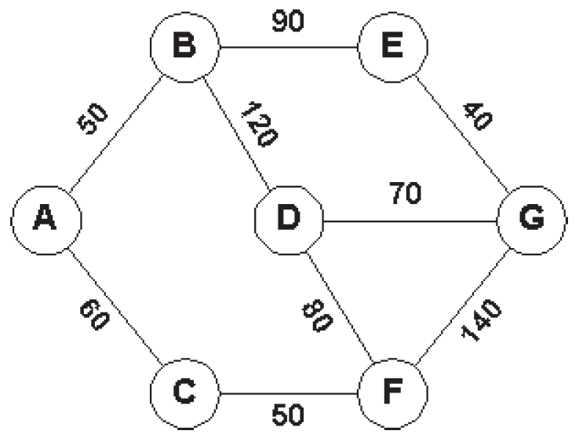
Problem Description(2/3)
The intensity level of normal conversation is 60.65 decibels and that of heavy traffic is 70.80 decibels. Consider the following city map where the edges refer to streets and the nodes refer to crossings. The integer on each edge is the average intensity level of sound (in decibels) in the corresponding street.

Slide 4
Problem Description(3/3)
To get from crossing A to crossing G you may follow the following path: A- C- F- G. In that case you must be capable of tolerating sound intensity as high as 140 decibels. For the paths A- B- E- G, A- B- D- G and A- C- F- D- G you must tolerate respectively 90, 120 and 80 decibels of sound intensity.There are other paths, too. However, it is clear that A- C- F- D- G is the most comfortable path sinceit does not demand you to tolerate more than 80 decibels.
In this problem, given a city map you are required to determine the minimum sound intensity level you must be able to tolerate in order to get from a given crossing to another.

Slide 5
Input
The input may contain multiple test cases. The first line of each test case contains three integers C(≤100), S(≤ 1000) and Q(≤10000)
C indicates the number of crossings (crossings are numbered using distinct integers ranging from 1 to C)
S represents the number of streets
Q is the number of queries
Each of the next S lines contains three integers: c1, c2 and d indicating that the average sound intensity level on the street connecting the crossings c1 and c2 (c1 ̸= c2) is d decibels.
Each of the next Q lines contains two integers c1 and c2 (c1 ̸= c2) asking for the minimum sound intensity level you must be able to tolerate in order to get from crossing c1 to crossing c2. The input will terminate with three zeros form C, S and Q.

Slide 6
Output
For each test case in the input first output the test case number (starting from 1) as shown in the sample output.
Then for each query in the input print a line giving the minimum sound intensity level (in decibels) you must be able to tolerate in order to get from the first to the second crossing in the query.
If there exists no path between them just print the line “no path”.
Print a blank line between two consecutive test cases.

Slide 7

Sample Input/Output
Number of crossings
Number of streets
Number of queries
C
S
Q
7 9 3
1 2 50
1 3 60
2 4 120
2 5 90
3 6 50
4 6 80
4 7 70
5 7 40
6 7 140
1 7
2 6
6 2
Case #1
80
60
60
60
1
3
50
90
50
2
5
40
120
7
70
140
4
6
80

Slide 8
Sample Input/Output
Number of crossings
Number of streets
Number of queries
C
S
Q
7 9 3
1 2 50
1 3 60
2 4 120
2 5 90
3 6 50
4 6 80
4 7 70
5 7 40
6 7 140
1 7
2 6
6 2
Case #1
80
60
60
60
1
3
50
90
50
2
5
40
120
7
70
140
4
6
80

Slide 9
Sample Input/Output
Number of crossings
Number of streets
Number of queries
C
S
Q
7 9 3
1 2 50
1 3 60
2 4 120
2 5 90
3 6 50
4 6 80
4 7 70
5 7 40
6 7 140
1 7
2 6
6 2
Case #1
80
60
60
60
1
3
50
90
50
2
5
40
120
7
70
140
4
6
80

Slide 10
Sample Input/Output
Number of crossings
Number of streets
Number of queries
C
S
Q
7 9 3
1 2 50
1 3 60
2 4 120
2 5 90
3 6 50
4 6 80
4 7 70
5 7 40
6 7 140
1 7
2 6
6 2
Case #1
80
60
60
60
1
3
50
90
50
2
5
40
120
7
70
140
4
6
80
40
50
50
60
70
80
90
120
140

Slide 11
Sample Input/Output
Number of crossings
Number of streets
Number of queries
C
S
Q
7 9 3
1 2 50
1 3 60
2 4 120
2 5 90
3 6 50
4 6 80
4 7 70
5 7 40
6 7 140
1 7
2 6
6 2
Case #1
80
60
60
60
1
3
50
90
50
2
5
40
120
7
70
140
4
6
80
40
50
50
60
70
80
90
120
140

Slide 12
Sample Input/Output
Number of crossings
Number of streets
Number of queries
C
S
Q
7 9 3
1 2 50
1 3 60
2 4 120
2 5 90
3 6 50
4 6 80
4 7 70
5 7 40
6 7 140
1 7
2 6
6 2
Case #1
80
60
60
60
1
3
50
90
50
2
5
40
120
7
70
140
4
6
80
40
50
50
60
70
80
90
120
140

Slide 13
Sample Input/Output
Number of crossings
Number of streets
Number of queries
C
S
Q
7 9 3
1 2 50
1 3 60
2 4 120
2 5 90
3 6 50
4 6 80
4 7 70
5 7 40
6 7 140
1 7
2 6
6 2
Case #1
80
60
60
60
1
3
50
90
50
2
5
40
120
7
70
140
4
6
80
40
50
50
60
70
80
90
120
140

Slide 14
Sample Input/Output
Number of crossings
Number of streets
Number of queries
C
S
Q
7 9 3
1 2 50
1 3 60
2 4 120
2 5 90
3 6 50
4 6 80
4 7 70
5 7 40
6 7 140
1 7
2 6
6 2
Case #1
80
60
60
60
1
3
50
90
50
2
5
40
120
7
70
140
4
6
80
40
50
50
60
70
80
90
120
140

Slide 15
Sample Input/Output
Number of crossings
Number of streets
Number of queries
C
S
Q
7 9 3
1 2 50
1 3 60
2 4 120
2 5 90
3 6 50
4 6 80
4 7 70
5 7 40
6 7 140
1 7
2 6
6 2
Case #1
80
60
60
60
1
3
50
90
50
2
5
40
120
7
70
140
4
6
80
40
50
50
60
70
80
90
120
140

Slide 16
Sample Input/Output
Number of crossings
Number of streets
Number of queries
C
S
Q
7 9 3
1 2 50
1 3 60
2 4 120
2 5 90
3 6 50
4 6 80
4 7 70
5 7 40
6 7 140
1 7
2 6
6 2
Case #1
80
60
60
60
1
3
50
90
50
2
5
40
120
7
70
140
4
6
80
40
50
50
60
70
80
90
120
140

Slide 17
Sample Input/Output
Number of crossings
Number of streets
Number of queries
C
S
Q
7 9 3
1 2 50
1 3 60
2 4 120
2 5 90
3 6 50
4 6 80
4 7 70
5 7 40
6 7 140
1 7
2 6
6 2
Case #1
80
60
60
60
1
3
50
90
50
2
5
40
120
7
70
140
4
6
80
40
50
50
60
70
80
90
120
140

Slide 18
Sample Input/Output
Number of crossings
Number of streets
Number of queries
C
S
Q
7 9 3
1 2 50
1 3 60
2 4 120
2 5 90
3 6 50
4 6 80
4 7 70
5 7 40
6 7 140
1 7
2 6
6 2
Case #1
80
60
60
60
1
3
50
90
50
2
5
40
120
7
70
140
4
6
80
40
50
50
60
70
80
90
120
140

